Slide 1
Domestic & Foreign Whistleblowers: The Growth & Spreading Reach of US Programs
Jane Norberg, Chief,
Whistleblower Office (SEC)
Christopher Ehrman, Director, Whistleblower Office (CFTC)
Dawn Applebaum, Program Manager, Whistleblower Office (IRS)
Eric Havian (moderator)
Offshore Alert Conference
December 7, 2020

Slide 2
Growth in Programs (SEC)

Slide 3
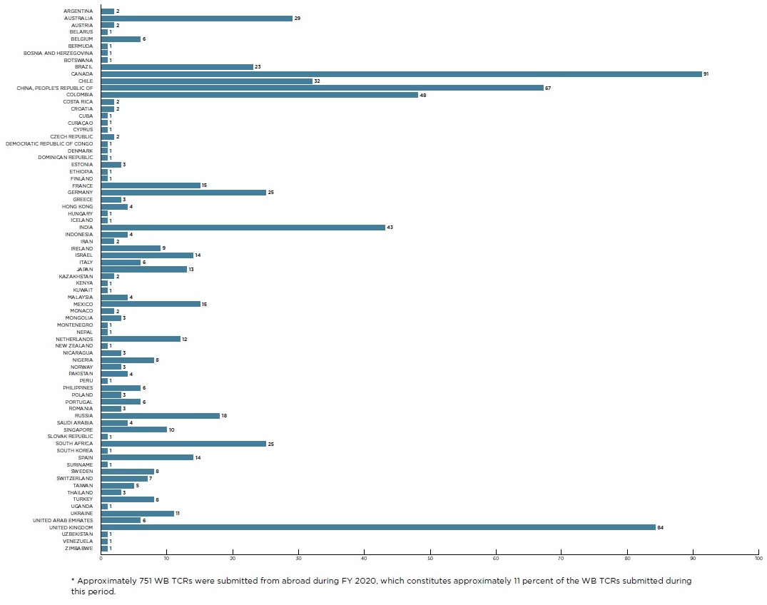
International Whistleblowing Trends (SEC)
After the U.S., most SEC tips from Canada, UK, China, and Colombia
(Source: SEC 2020 Annual Report to Congress on the Whistleblower Program)

Slide 4
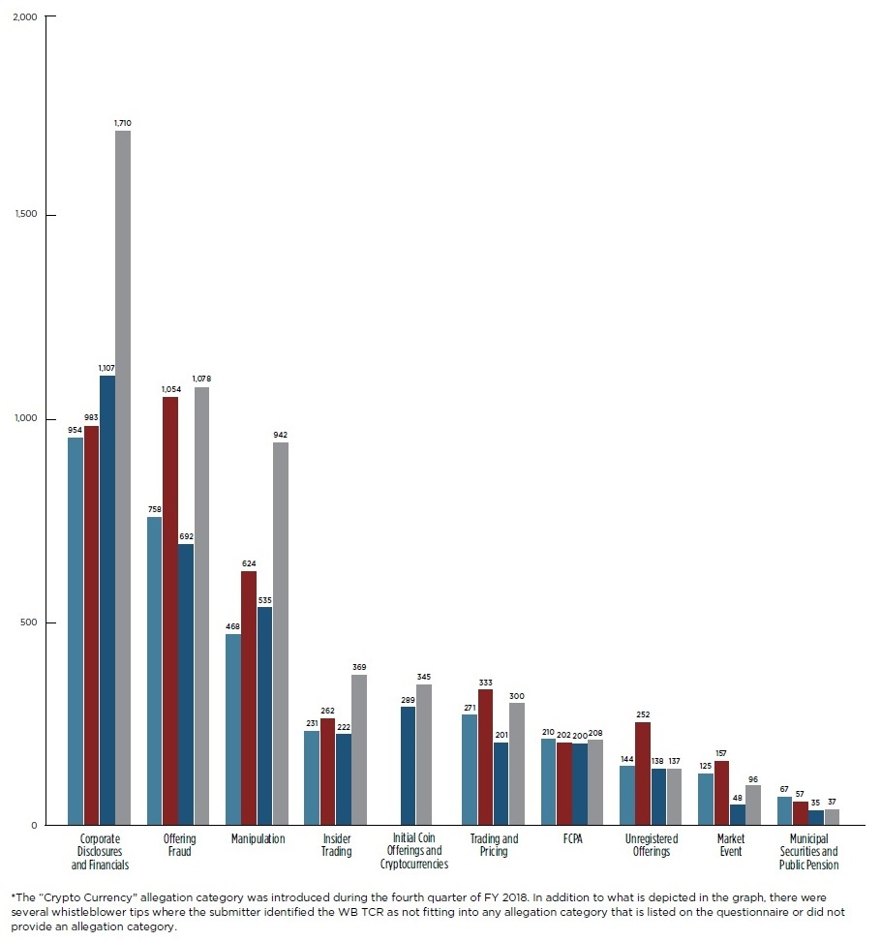
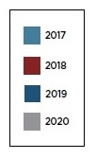
SEC Tips
(Source: SEC 2020 Annual Report to Congress on the Whistleblower Program)

Slide 5
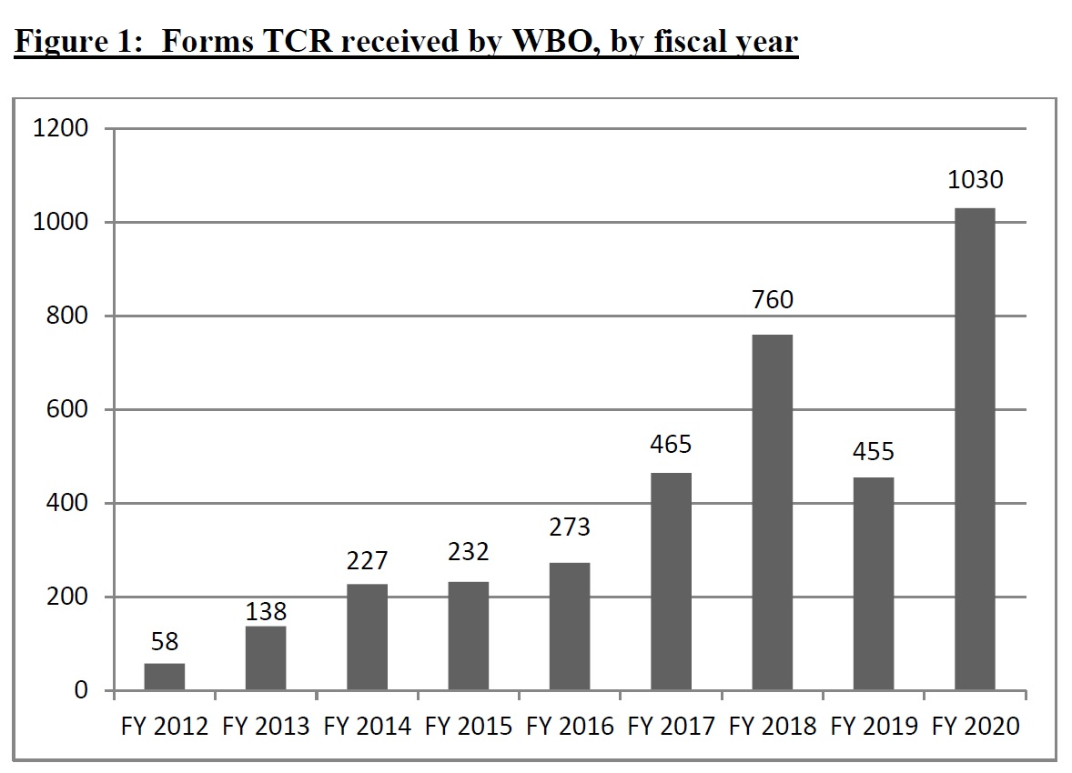
Growth in Programs (CFTC)
36% increase from previous highest year
(Source: CFTC 2020 Annual Report on the Whistleblower Program and Customer Education Initiatives)

Slide 6
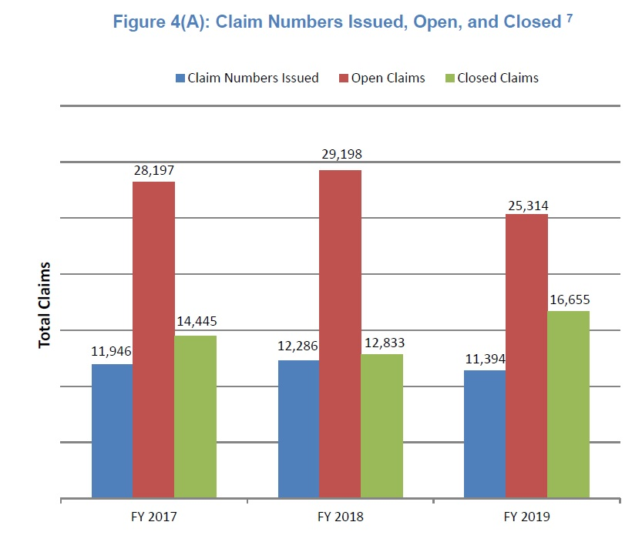
Growth in Programs (IRS)
(Source: IRS 2019 Annual Report to Congress on the Whistleblower Program)

Slide 7
Awards
IRS FY 2019: $120 million across 181 awards (24 of which were under the mandatory program 7623(b))
CFTC FY 2020: $20 million to 16 WBs
$9 million to one whistleblower, $6 million to another
2 foreign nationals or residents at time tips submitted
126% increase in tips over 2019
SEC FY 2020: $175 million to 39 WBs (more than in all prior years)
Largest ever award to a single individual ($114 million in FY 2021)
Total awards since inception over $500 million
40% were outsiders
19 recipients were foreign nationals or residents at time tips submitted

Slide 8
SEC 2020 Amendments
Presumption of 30% for awards under $5M (less than ≈ $17 million collected)
Currently two-thirds of awards are at or near 30%
Primary reason for reduction is delay (2 out of 39)
Need to provide TCR within 30 days of non-TCR submission
Safe harbor: 30 days from “actual or constructive” knowledge of requirement, or retention of attorney
SEC can waive
No share of “Related Action” if “separate award scheme [] more appropriately applies”
Summary disposition – two dedicated OWB attorneys
Codification of Digital Realty – must report to SEC pre-retaliation
Total of 12 enforcement actions; only 1 in 2020 (Collector’s Coffee)
Has deterrence worked?

Slide 9
CFTC Developments
Self-Report Guidance
Enforcement Task Forces
Parallel Investigations with DOJ and SEC
Collaboration with SEC on crypto currency
Focus on Education and Outreach
Customer Advisories/Whistleblower Alerts
Resources available on cftc.gov

Slide 10
IRS Developments
Proceeds now include criminal fines, FBAR penalties
Money laundering penalties
Anti-retaliation protections
Major enforcement priorities
Crypto currency – Darknet case against “Welcome to Video”
Micro captive insurance
Conservation easements

Slide 11
Practice Pointers
File electronically (SEC and CFTC)
Specific, detailed, timely, ongoing assistance
Can provide assistance to existing investigation (29% of SEC awards to date)
“Independent analysis” can qualify

Slide 12
COVID-19 Schemes

Slide 13
Fraud Follows Financial Decline
Following the 2008 crash
FBI reported a 52 percent increase in securities and commodities fraud investigations from 2008 to 2011
CFTC saw 155 percent growth in enforcement actions from 2008 to 2012
Since 2020 crash
CFTC and SEC have both seen increase in fraud complaints since March 2020
SEC statistics on COVID related fraud
Notes:
https://www.sec.gov/news/press-release/2020-146
https://www.sec.gov/news/press-release/2020-211
https://www.sec.gov/news/press-release/2020-262

Slide 14
Cryptocurrency Cases

Slide 15
Recent Cryptocurrency Enforcement Actions
SEC: $1.26 billion recovered from 8 enforcement actions against unregistered ICOs in FY 2020
Telegram Group Inc. – $18.5 million civil penalty and $1.2 billion in disgorgement (June 26, 2020)
Unikrn Inc. – $6.1 million penalty (Sept. 15, 2020)
Kik Interactive – $5 million penalty (Oct. 21, 2020)
345 tips on virtual currencies in 2020
Notes:
https://www.sec.gov/news/press-release/2020-146
https://www.sec.gov/news/press-release/2020-211
https://www.sec.gov/news/press-release/2020-262

Slide 16
Recent Cryptocurrency Enforcement Actions
CFTC:
Global Trading Club – ongoing (charged Sept. 14, 2020); fraudulently solicited funds to speculate in Bitcoin
PaxForex – ongoing (charged Sept. 28, 2020); engaged in unlawful transactions and failed to register as a futures commission merchant
Jon Thompson – $7.4 million in restitution (Oct. 2, 2020); false statements by principal of cryptocurrency escrow company
IRS:
John McAfee – ongoing (indicted June 15, 2020)
Notes:
https://www.cftc.gov/PressRoom/PressReleases/8241-20
https://www.cftc.gov/PressRoom/PressReleases/8256-20
https://www.cftc.gov/PressRoom/PressReleases/8272-20
https://www.justice.gov/usao-sdny/pr/principal-cryptocurrency-escrow-company-pleads-guilty-multimillion-dollar-fraudulent
https://www.justice.gov/opa/pr/john-mcafee-indicted-tax-evasion

Slide 17
Foreign Bribery (FCPA)

Slide 18
Foreign Corrupt Practices Act
Prohibits the payment of bribes to foreign officials to get business
Applies to:
“issuers”
Companies listed on a U.S. national securities exchange
Companies who file SEC reports because their stock is traded in the OTC market (e.g. ADRs)
“domestic concerns” (U.S. companies, nationals and residents)
foreign nationals and companies that, while in the U.S., engage in any act in furtherance of a corrupt payment
Requires issuers to maintain adequate “internal controls”
FCPA violations are investigated by the SEC and DOJ
SEC has civil enforcement authority over issuers and their agents
DOJ has criminal enforcement authority over issuers and civil and criminal enforcement authority over b) and c)

Slide 19
SEC/DOJ Cases in 2016 - 2020 for FCPA Violations
Offender | Amount | Description
Airbus – 2020 | $3.9 billion | Bribery payments in China, Ghana, Indonesia, Malaysia, Sri Lanka, and Taiwan.
Odebrecht – Braskem – 2016 | $3.5 billion | Bribery payments in Brazil and other countries related to construction projects.
Goldman Sachs (Malaysia) – 2020 | $2.9 billion | Bribery payments ($1.6 billion) in Malaysia and UAE.
Ericsson (Sweden) – 2019 | $1 billion | Bribery payments in China, Djibouti, Indonesia, Kuwait, and Vietnam.
Telia Company AB (Sweden) – 2017 | $965 million | Bribery payments ($331 million) to shell company ultimately owned by Gulnara Karimova (President’s daughter).
Petrobras – 2018 | $853 million | Bribery payments to Brazilian officials.
Notes:
https://www.justice.gov/opa/pr/airbus-agrees-pay-over-39-billion-global-penalties-resolve-foreign-bribery-and-itar-case
https://www.justice.gov/opa/pr/odebrecht-and-braskem-plead-guilty-and-agree-pay-least-35-billion-global-penalties-resolve
https://www.justice.gov/opa/pr/goldman-sachs-charged-foreign-bribery-case-and-agrees-pay-over-29-billion
https://www.justice.gov/opa/pr/ericsson-agrees-pay-over-1-billion-resolve-fcpa-case
https://www.justice.gov/opa/pr/telia-company-ab-and-its-uzbek-subsidiary-enter-global-foreign-bribery-resolution-more-965
https://www.justice.gov/opa/pr/petr-leo-brasileiro-sa-petrobras-agrees-pay-more-850-million-fcpa-violations

Slide 20
SEC/DOJ Cases in 2016 - 2020 for FCPA Violations
Offender | Amount | Description
MTS (Russia) – 2019 | $850 million | Bribery payments ($420 million) to shell company ultimately owned by Gulnara Karimova (President’s daughter).
VimpleCom (Netherlands) – 2016 | $795 million | Bribery payments ($114 million) to shell company ultimately owned by Gulnara Karimova (President’s daughter).
Société Générale (France) – 2018 | $585 million | Bribery payments to Libyan officials through a broker in order to obtain investments from state-owned institutions.
Teva Pharmaceuticals (Israel) – 2016 | $519 million | Bribery payments in Ukraine and Russia (SEC $236M) Public information suggests investigation may have been sparked by the tips of several whistleblowers.
Novartis (Switzerland) – 2020 | $345 million | Bribery payments to employees of state-owned hospitals in Greece and Vietnam.
Technip/FMC (Unaoil) – 2019 | $296 million | Bribery payments to Brazilian and Iraqi officials. Public information suggests investigation may have been sparked by whistleblower tip to reporter.
Notes:
https://www.justice.gov/opa/pr/mobile-telesystems-pjsc-and-its-uzbek-subsidiary-enter-resolutions-850-million-department
https://www.justice.gov/opa/pr/vimpelcom-limited-and-unitel-llc-enter-global-foreign-bribery-resolution-more-795-million
https://www.justice.gov/opa/pr/soci-t-g-n-rale-sa-agrees-pay-860-million-criminal-penalties-bribing-gaddafi-era-Libyan
https://www.justice.gov/opa/pr/teva-pharmaceutical-industries-ltd-agrees-pay-more-283-million-resolve-foreign-corrupt
https://www.justice.gov/usao-nj/pr/novartis-ag-and-subsidiaries-pay-345-million-resolve-foreign-corrupt-practices-act-cases
https://www.justice.gov/opa/pr/technipfmc-plc-and-us-based-subsidiary-agree-pay-over-296-million-global-penalties-resolve

Slide 21
SEC/DOJ Cases in 2016 - 2020 for FCPA Violations
Offender | Amount | Description
Walmart (Brazil) – 2019 | $283 million | Bribery payments in Brazil, China, India, and Mexico.
Panasonic – 2018 | $280 million | Offered sham consulting positions to government officials.
J&F Investimentos (Brazil) – 2020 | $256 million | Bribery payments to Brazilian officials in order to obtain financing from state-controlled banks.
SBM (Unaoil) – 2017 | $238 million | Bribery payments to Brazilian officials. Public information suggests that investigation may have been sparked by whistleblower tip to reporter.
Fresenius Medical (Germany) – 2019 | $231 million | Bribery payments in Angola and Saudi Arabia.
Herbalife (US) – 2020 | $122 million | Bribery payments to Chinese officials.
Notes:
https://www.justice.gov/opa/pr/walmart-inc-and-brazil-based-subsidiary-agree-pay-137-million-resolve-foreign-corrupt
https://www.justice.gov/opa/pr/panasonic-avionics-corporation-agrees-pay-137-million-resolve-foreign-corrupt-practices-act
https://www.justice.gov/opa/pr/jf-investimentos-sa-pleads-guilty-and-agrees-pay-over-256-million-resolve-criminal-foreign
https://www.justice.gov/opa/pr/sbm-offshore-nv-and-united-states-based-subsidiary-resolve-foreign-corrupt-practices-act-case
https://www.justice.gov/opa/pr/fresenius-medical-care-agrees-pay-231-million-criminal-penalties-and-disgorgement-resolve
https://www.justice.gov/opa/pr/herbalife-nutrition-ltd-agrees-pay-over-122-million-resolve-fcpa-case

Slide 22
Asset Recovery Assistance

