Slide 1


Understanding How Litigation Claims Get Funded
Offshore Alert
December 2020

Slide 2
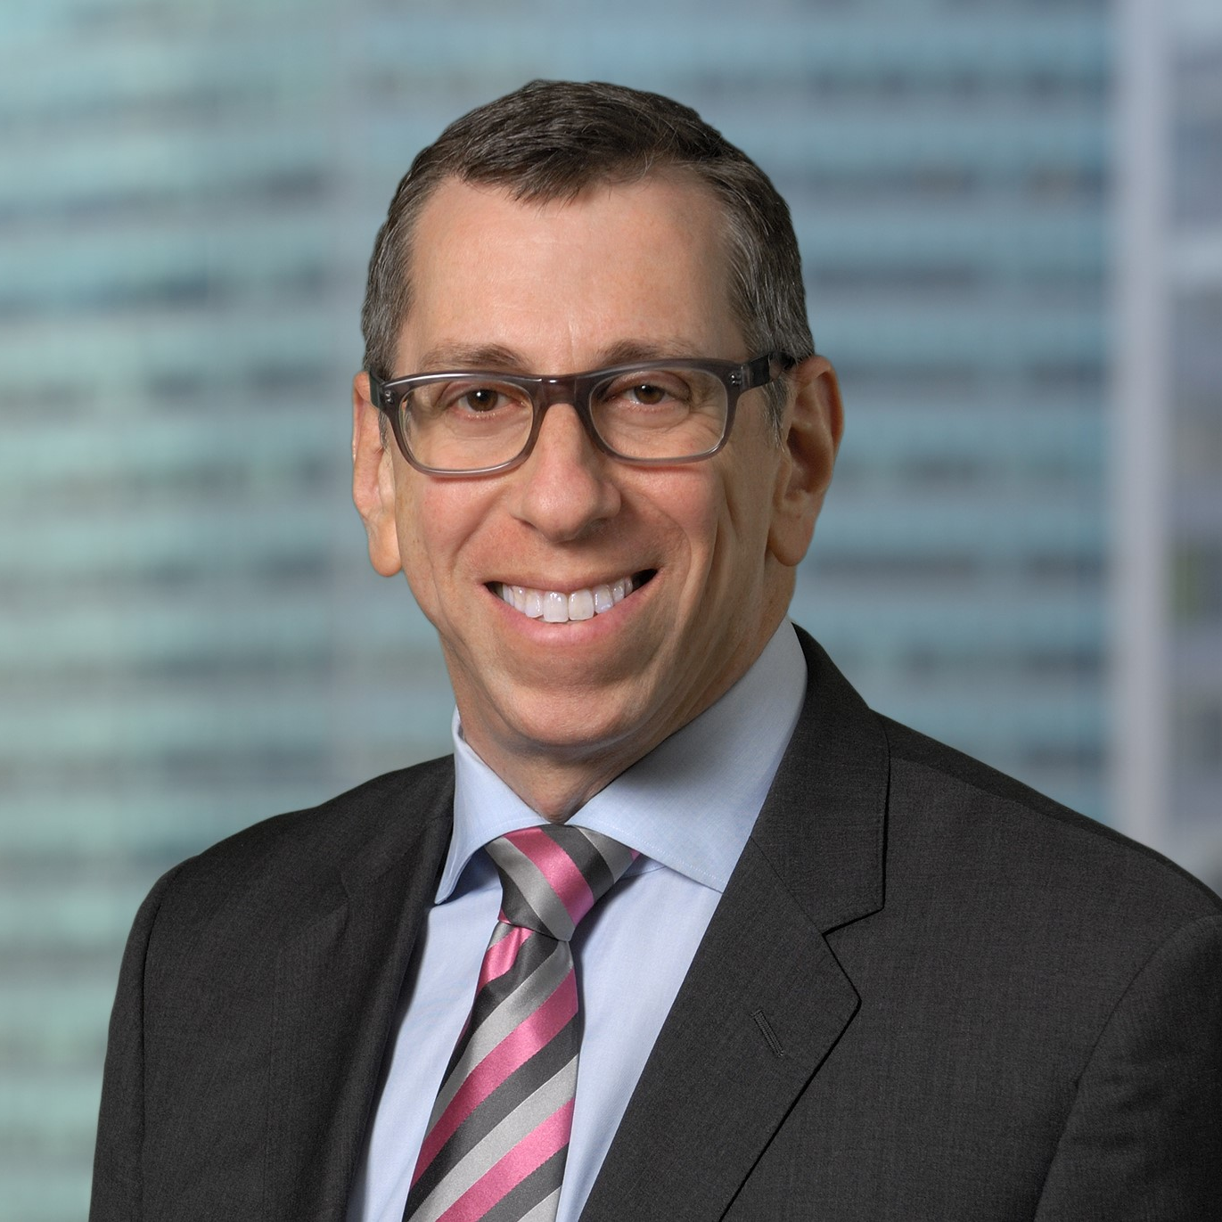
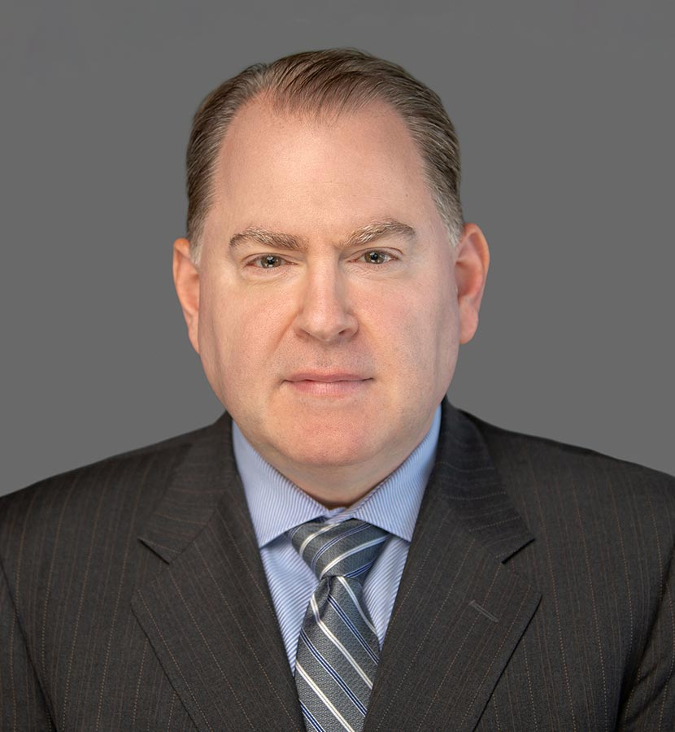
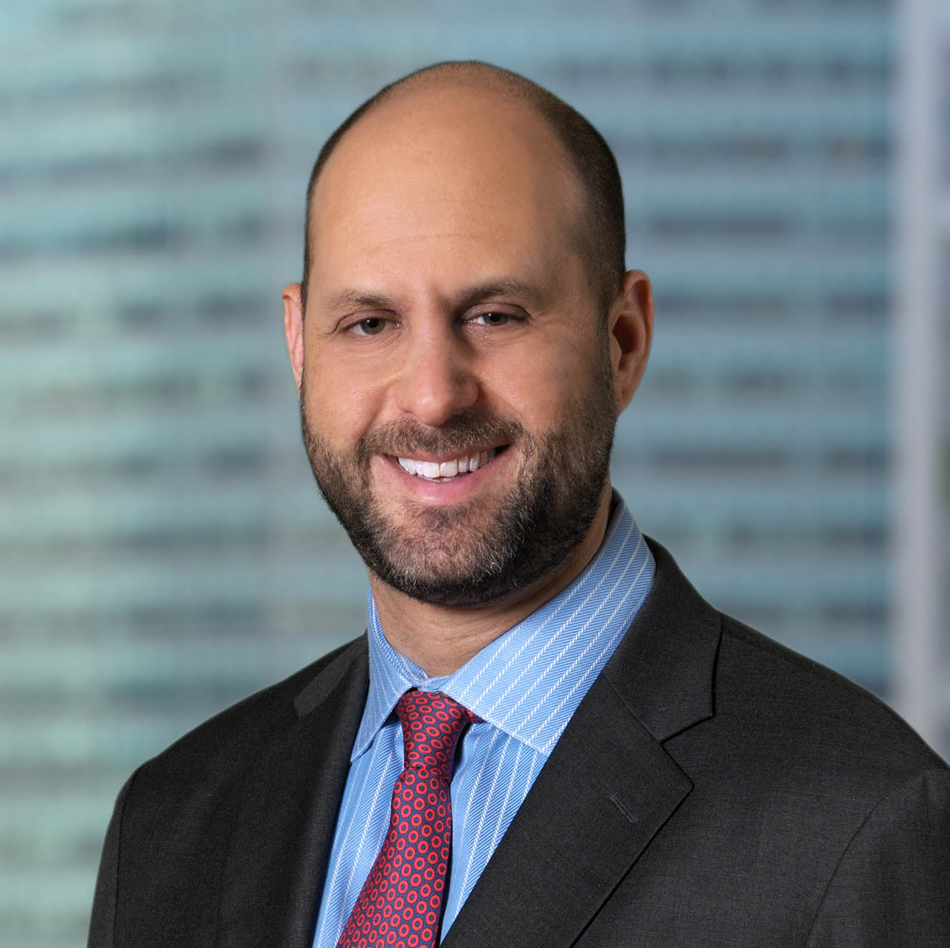
Meet the Speakers
Ralph J. Sutton
Founder & CEO
Validity Finance
E. ralph@validity-finance.com
T. 646.798.7168
Christopher Delise
Managing Principal, CEO, and
Co-Chief Investment Officer
Delta Capital Partners
E. cdelise@deltacph.com
T. 312.414.0860
David J. Kerstein
Chief Risk Officer & Senior Investment Manager
Validity Finance
E. dave@validity-finance.com
T. 646.798.7168

Slide 3



Meet the Funders
Who We Are
Type of Claims
Where We
Operate

Slide 4
Current Trends in Litigation Finance
Increased demand for credit-oriented funding products (rather than traditional equity-based products) in order to obtain capital at lower overall cost
AmLaw 100 and larger law firms have increased demand for capital facilities and other liquidity solutions in wake of COVID-19
Increased direct solicitation of funders by corporations and businesses (rather than going through their law firms)
Demand for bespoke programs and other solutions for law firms to fund full or partial contingency fees and offer funded proposals to their clients
Niche geographic markets, including international markets are becoming more sophisticated, seeking funding with interesting opportunities

Slide 5

HOW IT WORKS
Meet Mr. Niceguy
The Plaintiff: Jim Niceguy, CEO,
Offshore Funding International
His Claim: Breach of fiduciary duty and fraud against Ponzi Badguys Inc.
The Legal Budget:
  Legal fee estimates: $4-6 million
  Costs estimates: $1-2 million
Damages Estimate: $60-80 million

Slide 6
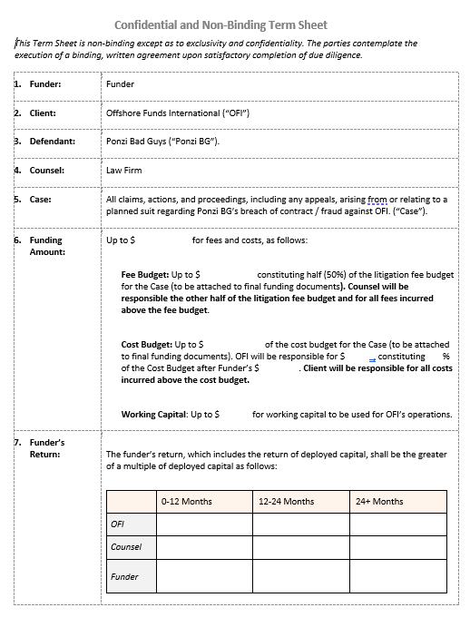
HOW IT WORKS
TS Breakdown: 4 Moving Parts
Funding
Return
Waterfall
Exclusivity

Slide 7
HOW IT WORKS
Term Sheet Inputs
Case | Claim Type | Law Firm 50-50 Fee Share? | Attorney’s Fee Budget | Costs Budget | Working Capital?
Offshore v. Ponzi | Breach of Fiduciary Duty / Fraud | Yes | $4-6M | $1.5M | $500,000
Time to Trial | Damages Range | Client Contribution to Costs? | Early Settlement | Exclusivity Period | Principal Protection From Other Cases?
~24 months | $60-80M | Yes. $250,000-$500,000 | Unlikely | 30-45 days | No

Slide 8
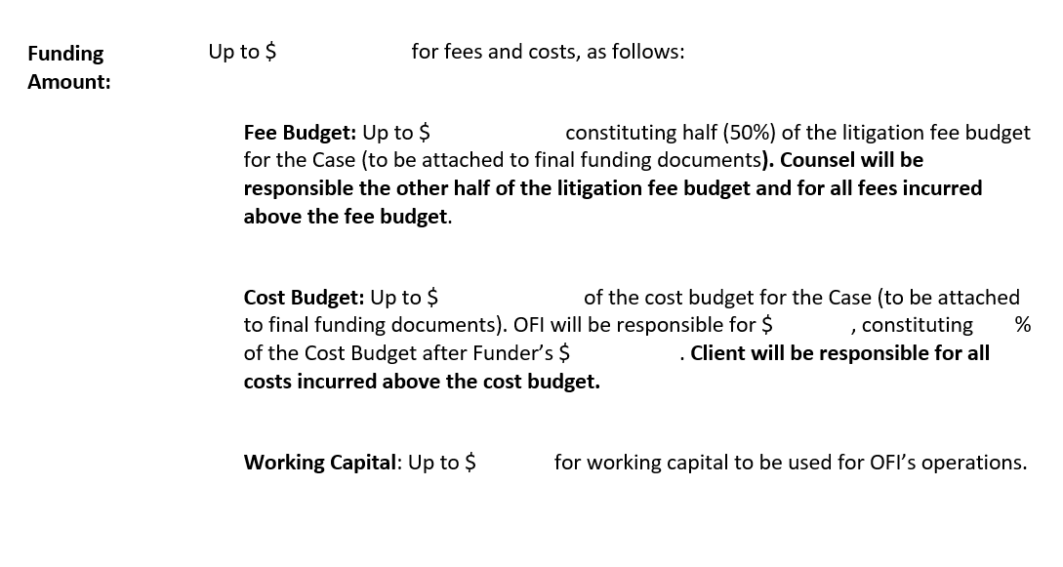
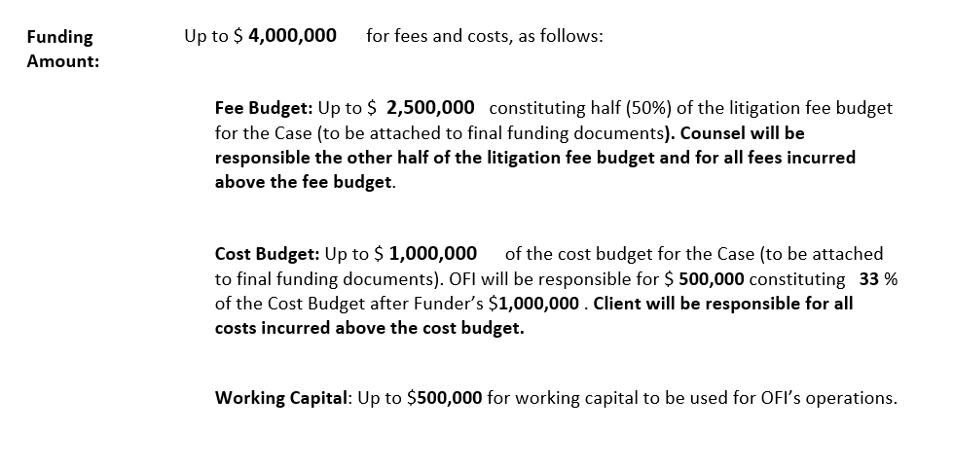
HOW IT WORKS
Fee Budget
$4-6M
Costs Budget
$1-2M
Working Capital
$500K
Damages Range
$60-80M
Client Contribution
$500,000
Completing TS: Funding
*Client contribution is 11% of total commitment

Slide 9
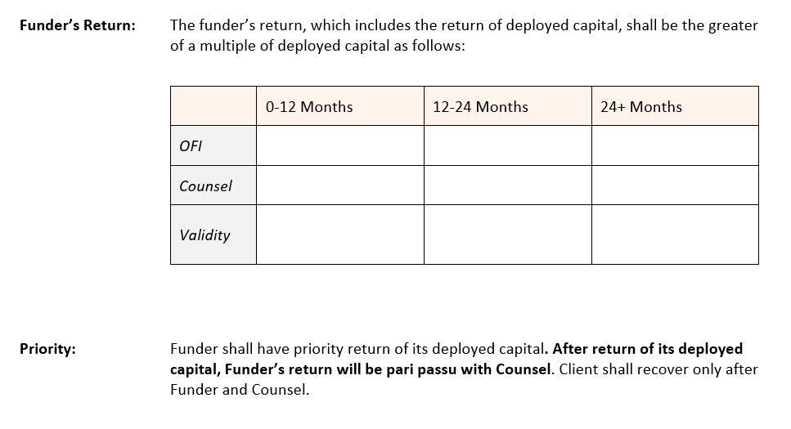
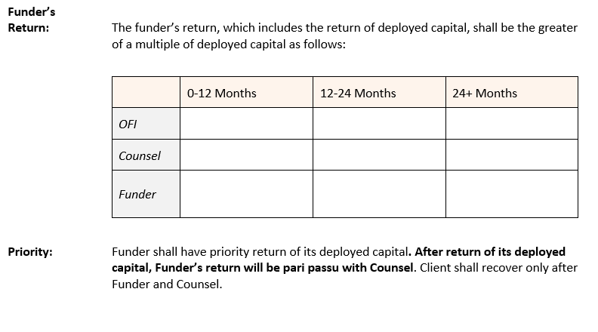
HOW IT WORKS
Claim Type
Breach of Fiduciary Duty / Fraud
Time to Trial:
24 Months
Damages Range
$60-80M
Principal Protection
No
Completing TS: Return/Priority
65% | 60% | 57.5%
17.5% | 20% | 20%
Greater of 2x and 17.5% | Greater of 3x and 20% | Greater of 3.5x and 22.5%

Slide 10
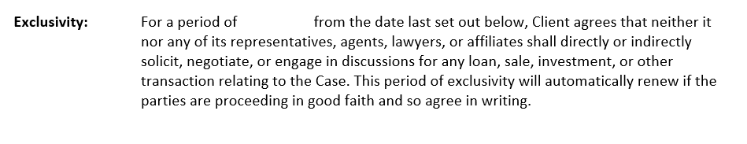
HOW IT WORKS
Completing TS: Exclusivity
30 days

Slide 11



CLOSING A DEAL
From TS to Closing
Underwriting
Contract
Negotiation
Approval
Typically, 30 to 45 days from TS execution to funding depending on complexity of the matter and ease of information exchange
What should claimants prepare for funders?
What is difference between transaction and merits DD?
When should parties negotiate their agreement?

